Slide 1
Impact of public health policies on spread and fatality rate of COVID-19
Vathana Him, Drew Lindberg, Dajonna Williams

Slide 2







Slide 3
Global Air Traffic in a 24 Hour Period

Slide 4
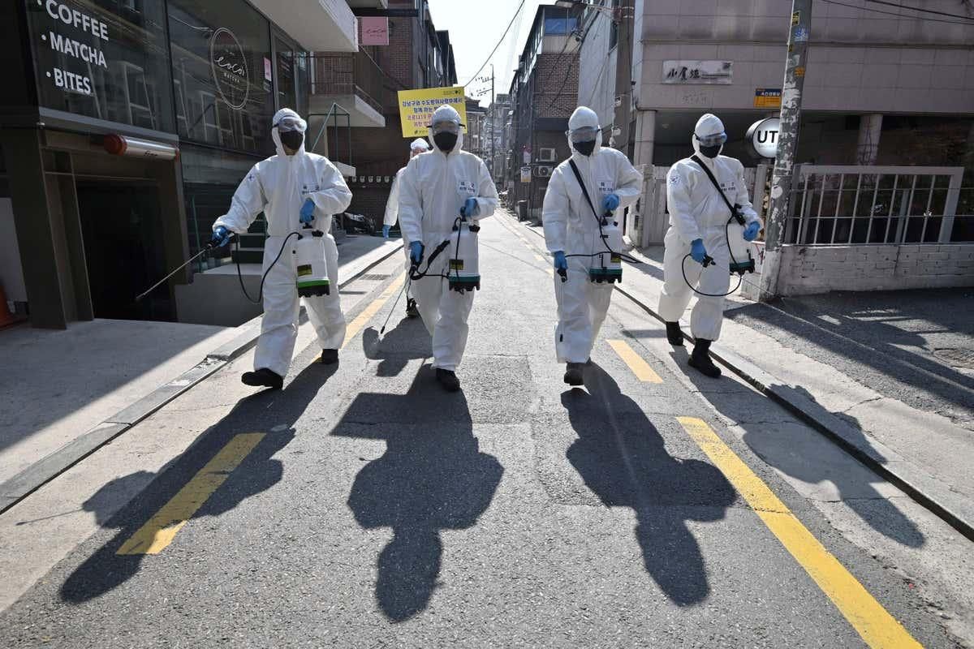

Slide 5
Introduction
Novel Coronavirus Covid-19 was declared a pandemic by WHO on March 11th, 2020
One of the worst infectious diseases that impacted the world in modern history
Caused countries around the globe to scramble and find ways to fight it
Each country has different approaches in slowing down the virus
Notes:
however each countries have different response time and approaches to prevent the spread of the virus

Slide 6
Plan
Data:
Oxford university dataset that quantitatively measure government responses
Johns Hopkin University GitHub Repo
Analysis:
Time series model and Linear Regression model
Predictive model of linear regression

Slide 7

Motivation
Intense political debate surrounding differences in government response to the pandemic
Examine different public health policies in curbing the virus between different first world countries in South Korea, Sweden and The United States
Explore how responses varies and how it impacted the spread of the virus

Slide 8




Technologies
SQLite
Seaborn
Pyspark
Sci-Kit Learn

